Slide 1
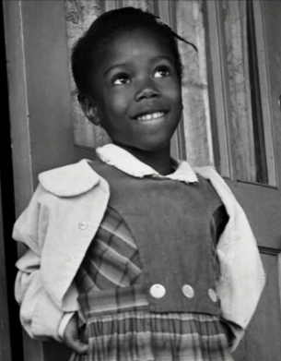
Ruby
Bridges
(Feb 6-10)

Slide 2
Monday, February 6th
Greeting | 3 H’s
Share | Watch Video https://www.flocabulary.com/unit/ruby-bridges/ Ruby persevered to help integrate schools. What are some ways you persevere in school?
Message | (each homeroom can add their own message (announcements etc))
Activity | Ruby Bridges password

Slide 3
Wednesday, February 8
Greeting | Peace sign greeting
Share | What does this quote mean to you?
Message | Ruby believes that a person who has courage and perseveres through things that are hard can be leaders and create new paths in life. Let’s keep this in mind as we work hard in school and remember to always do our best!
Activity | Silent Ball
“Don’t follow the path. Go where there is no path and begin the trail! When you start a new trail...with courage, strength and “beliefs”, the only thing that can stop you is you!”
-Ruby Bridges

Slide 4
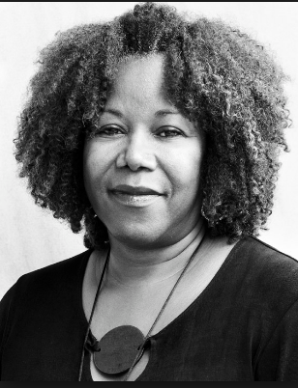
Tuesday, February 7
Greeting | Professional Handshake
Share | Read the quote by Ruby Bridges. Why should our class community be like “a village”?
Message | It’s always a great day to be a good friend. Let’s try to find ways that we can build up our community and be good to each other! We are a village and we can take care of each other in many ways too!
Activity | Human Knot

Slide 5
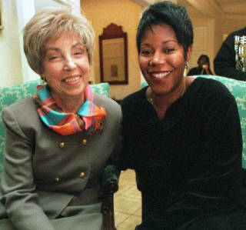
Thursday, February 9
Greeting | High Five You’re awesome
Share | Ruby shared about a teacher who helped her every day at school to make her feel like she was part of a community. How has an adult made you feel like you are a part of our community?
Message | Remember that your teachers and other adults are here to help you succeed. They care about your work, your effort and your futures. Let’s do our best to tell an adult today how they make a difference in our lives! We are proud of all the hard work you have done this year. Keep it up!:)
Activity | Coseeki
http://racialsegregationbymjk.weebly.com/parents.html
Start video at 2:40

Slide 6
Happy Friday, February 10th!
Greeting | High five you’re awesome
Share | After watching the video, what is one question you would ask Ruby?
Message | As we learn today let’s do our best to remind ourselves that we can persevere through anything, just like Ruby did! If you set your mind to it, work hard, and don’t give up you can accomplish your goals even if things get tough. Let’s do our best today and everyday!:)
Activity | Ghosts in the Graveyard
Scholastic interview with Ruby Bridges
https://www.scholastic.com/teachers/videos/teaching-content/ruby-bridges-interview/

